Slide 1


Taxi Demand Prediction- New York City
Team Member :
Ankush Kumar Singh
Baibhav Tripathi
Chitranshu Gupta

Slide 2
Problem Definition
For a given location in New York City, our goal is to predict the number of pickups in that given location at particular time interval. Some location require more taxis at a particular time than other locations owing to the presence schools, hospitals, offices etc. The prediction result can be transferred to the taxi drivers, and they can subsequently move to the locations where predicted pickups are high.

Slide 3
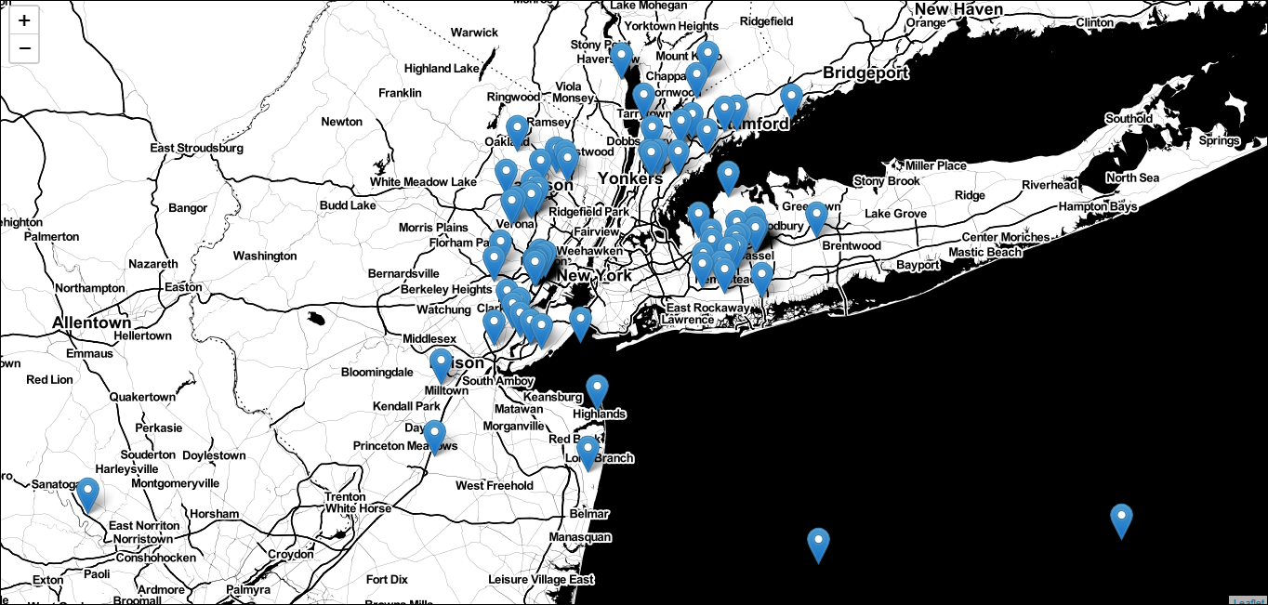

Slide 4
Motivation
Making transportation more efficient
Predictive models like these are interesting for many people, including of course the taxi companies themselves.
Taxi companies: Companies can maximize their utilization by diverting the cabs into the locations during specific times.
Traffic planning: Planners can use the model predictions for traffic management on specific day/time/locations. The model can be enhanced in future to incorporate features like weather, holiday etc.
Data scientists: It is interesting for data scientists to see how we have modeled location data in a simple way and yet able to get reasonably good predictions.

Slide 5
Problem formulation :
Time-series forecasting and Regression:
To find a number of pickups, given location coordinates(latitude and longitude) and time,
in the query region and surrounding regions.
To solve the above we would be using data collected in
Jan — Mar 2015 to predict the pickups in Jan — Mar 2016.

Slide 6
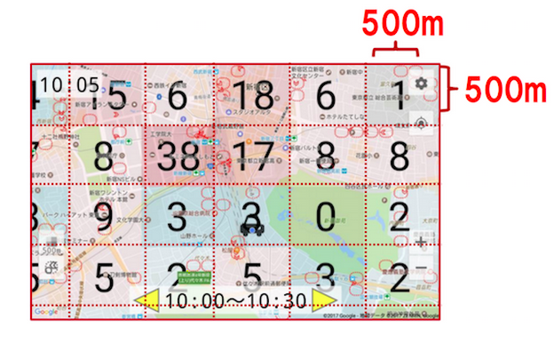

Slide 7
Literature Survey :
NTT DOCOMO, Japan’s largest mobile service provider, has launched
a demand forecasting service for taxi operators, starting in February, 2018.
The service collects real-time people density from mobile phones and runs
data analytics with a deep learning model on TensorFlow to predict how
many possible riders could be waiting in each block or street in the next
30 minutes, with 93-95% accuracy.
Today, over 2,500 taxis in Tokyo and other major Japanese cities use the service.

Slide 8
How it works :
The system uses the following data as input for the demand forecast.
Connection density statistics from NTT DOCOMO’s mobile network.
Taxi location and activity from each vehicle.
Weather data (similar to real-time NOAA global surface summary data).
NTT DOCOMO collects 60M subscribers' location information from its
cellular network. Considering the customers' privacy, they anonymize
individual person location by applying masking.
NTT DOCOMO explains that their taxi demand forecast system
is greatly improved the accuracy by using their real-time
population density data.

Slide 9
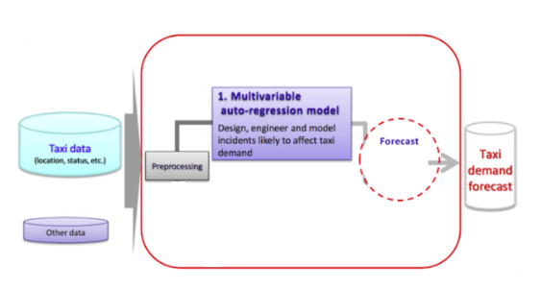

Slide 10
Objective
Our objective is to predict the number of pickups as accurately as possible for each region in a 10 min interval. We will break up the whole New York City into regions. Now, the 10 min interval is chosen because in NYC one can commute 1 mile in approximately 10 minutes given the traffic is normal at that particular time.

Slide 11
Objective:
Shorten the average wait time of each rider.
Quickly respond to sudden change of demands.
Reduce the performance gap between experienced drivers and novice drivers.
These benefits are delivering a notable revenue boost for taxi operators.

Slide 12
Proposed System architecture
Software and Hardware requirements
Implementation Details
Python3 – code
Machine Learning
Data Analysis
System Specifications
CPU – Intel Core i7/i5 3.60 Ghz
RAM – 16 Gb GPU – Nvidia/AMD
Google Cloud

Slide 13
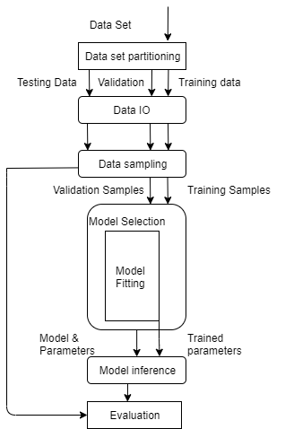
Data Flow Diagram

Slide 14
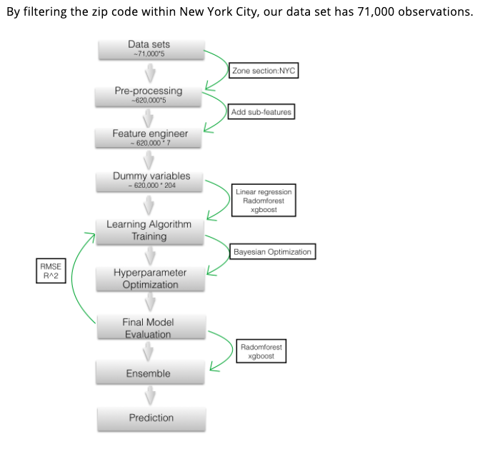
PROCESS DIAGRAM

Slide 15
Algorithms:
Multiple Linear Regression.
Random Forest Regressor.
XGBoost Regressor.
Ensemble Modelling.
Model Comparison.

Slide 16
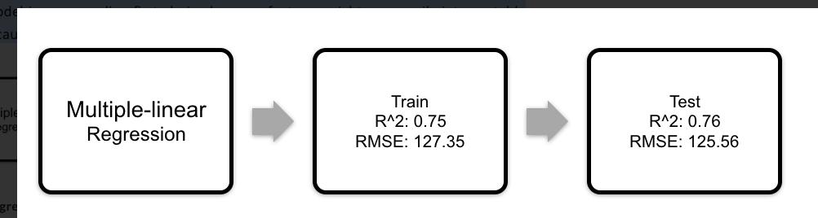
Multiple Linear Regression
The multiple-linear regression model allows us to exploit linear patterns in the data set. This model is an appealing first choice because feature weights are easily interpretable and because it runs efficiently on large datasets. The result is showed below.

Slide 17
Random Forest Regressor
The tree regression model is capable of representing complex decision boundaries, thus complementing our other chosen models. Random Forest is chosen since it prevents overfitting and robust against outliers. And the hyperparameters max-features(number of splits at each tree) and n-estimators (number of tress) are determined using Bayesian Optimization select parameter values. Of the values we swept, our model performed best with max-features 14 and n-estimators of 500.

Slide 18
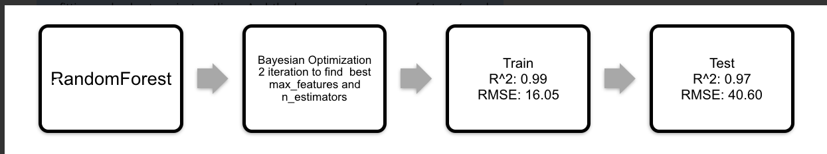
Random Forest - Result

Slide 19
XGBoost
XGBoost is an advanced gradient boosting algorithm. It is a highly sophisticated algorithm, powerful enough to deal with all sorts of irregularities of data. The tool is extremely flexible, which allows users to customize a wide range of hyper-parameters while training the mode, and ultimately to reach the optimal solution.

Slide 20
XGBoost
For our model, the booster parameters are tuned byBayesian Optimization to find the best combination of hyperparameters (listed in the table), where max_depth is the maximum depth of a tree, learning_rate determines the impact of each tree on the final outcome ignorer to avoid overfitting, n_estimators is the number of trees, gamma is the minimum loss reduction at each split, min_child_weight is the minimum sum of weights of all aberrations required at each split node, subsample is the fraction of observations randomly sampled for each tree and closample_bytree is the fraction of columns randomly sampled for each tree.

Slide 21
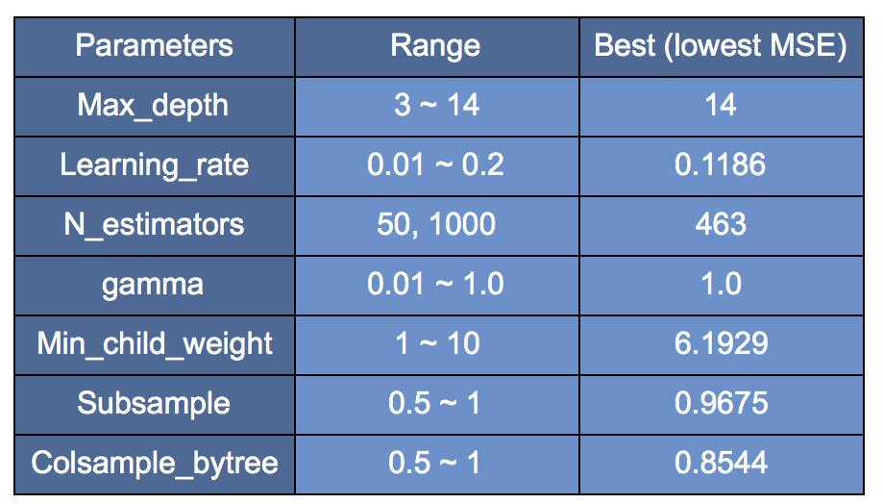
XGBoost Hyper-parameters

Slide 22
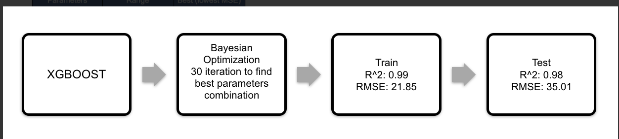
XGBoost - Result

Slide 23
Ensemble Modeling
Ensemble modeling is the process of running two or more related but different analytical models and then synthesizing the results into a single score or spread in order to improve the accuracy of predictive analytics and data mining applications. We combined our two strong models: randomforest and xgboost for ensemble modeling and used linear regression.

Slide 24
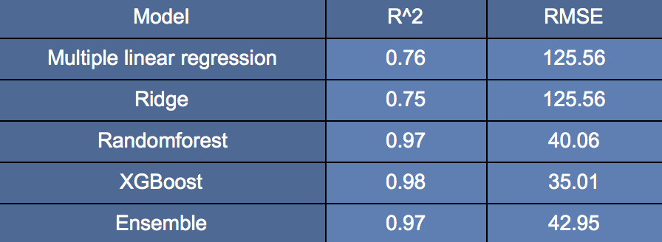
Ensemble - Result

Slide 25
Final Verdict
The results of all the models are compared in the below table, and ensemble modeling did not further improve the prediction as expected. Overall xgboost performs best.

Slide 26
Model Analysis
In order to visualize how well the models (randomforest, xgboost, ensemble) perform, we ploted scatter plot for the actual numbers versus predicted number of pickups for each data point in the test set in the Figure.

Slide 27
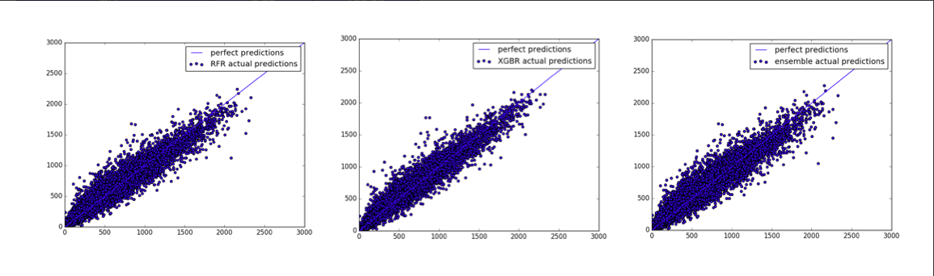
Model Analysis

Slide 28
Work till now
Project name and information gathering
Synopsis Completion
Data collection
Data cleaning
Feature identification
Model decision
Model Implementation – Work in progress
Research paper submitted

Slide 29
References
https://cloud.google.com/blog/products/gcp/now-live-in-tokyo-using-tensorflow-to-predict-taxi-demand
https://medium.com/@ranasinghiitkgp/taxi-demand-prediction-in-new-york-city-916cde6a3492
https://sdaulton.github.io/TaxiPrediction/
https://www.researchgate.net/publication/220579543_Context-aware_taxi_demand_hotspots_prediction

Slide 30
Thank you….

